Slide 1
L
3) Response: changed rotation direction to clockwise
1) Stimulus: ligand
L
L
L
L
Extracellular Space
Receptor
Cellular membrane
Chesson P.. Mechanisms of maintenance of species diversity. Annu Rev Ecol Evol Syst 31: 343-366 https://journals.plos.org/ploscompbiol/article?id=10.1371/journal.pcbi.1008010
Cytoplasm
2) Signaling Events
Notes:
chemotaxis_signal

Slide 2
3) Response: changed rotation direction to clockwise
1) Stimulus: ligand
L
L
L
Extracellular Space
MCP
Cellular membrane
Chesson P.. Mechanisms of maintenance of species diversity. Annu Rev Ecol Evol Syst 31: 343-366 https://journals.plos.org/ploscompbiol/article?id=10.1371/journal.pcbi.1008010
Cytoplasm
CheW
P
CheA
P
CheY
CheZ
ATP
ADP
CheY
P
2) Signaling Events
Notes:
chemotaxisphosnew

Slide 3
L
L
L
Extracellular Space
MCP
Cellular membrane
Chesson P.. Mechanisms of maintenance of species diversity. Annu Rev Ecol Evol Syst 31: 343-366 https://journals.plos.org/ploscompbiol/article?id=10.1371/journal.pcbi.1008010
Cytoplasm
+CH₃
CheR
CheW
-CH₃
P
CheA
P
CheB
ATP
ADP
P
CheB

Slide 4
L
Response: changed rotation direction to clockwise
Stimulus: ligand
L
L
Extracellular Space
MCP
Cellular membrane
+CH₃
Cytoplasm
CheR
CheW
-CH₃
P
CheA
P
P
CheY
CheB
CheZ
ATP
ADP
P
CheB
CheY
P
Adaptation
Notes:
chemotaxis_wholestory

Slide 5
L
L
Receptor
Receptor
Pr(LT → L + T ) = k_{dissociate} · [LT] / r_{total}
Receptor
L
L
L
Receptor
Receptor
r_{total} = k_{bind} · [L] · [T] + k_{dissociate} · [LT]
Receptor
L
Pr(L + T → LT) = k_{bind} · [L] · [T] / r_{total}
L
L
Receptor
Receptor
L
Receptor
δ · t ~ 1/ r_{total}
t
t + δ · t
Expected Wait time

Slide 6
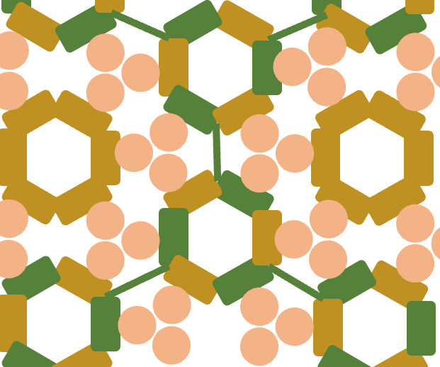
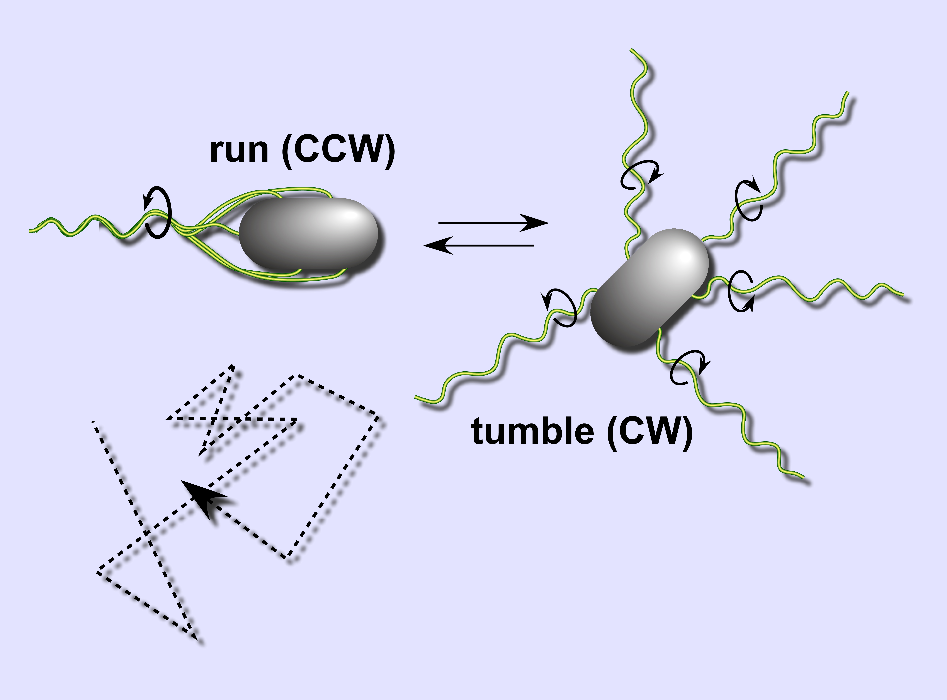
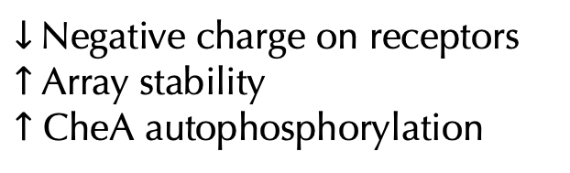

+CH₃
$↓$ Negative charge on receptors
$↑$ Array stability
$↑$ CheA autophosphorylation
$↑$ CheY phosphorylation
$↑$ Tumbling frequency
+CH₃
CheW
CheA
MCP
MCP
MCP
MCP
MCP
MCP
CheA
CheW

Slide 7
Scratch, please ignore
CheW
CheA
MCP
MCP
MCP
MCP
MCP
MCP
CheA
CheW

